Slide 1
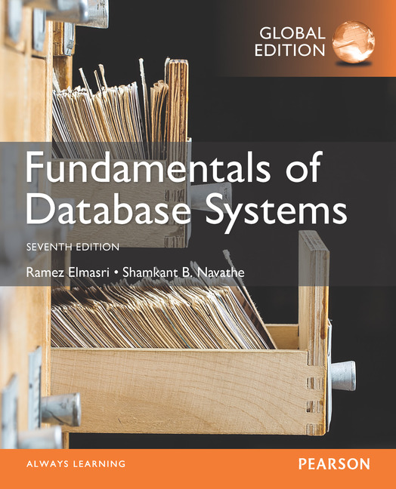

Slide 2
CHAPTER 16
Disk Storage, Basic File Structures, Hashing, and Modern Storage Architectures

Slide 3
16.1 Introduction
Databases typically stored on magnetic disks
Accessed using physical database file structures
Storage hierarchy
Primary storage
CPU main memory, cache memory
Secondary storage
Magnetic disks, flash memory, solid-state drives
Tertiary storage
Removable media

Slide 4
Memory Hierarchies and Storage Devices
Cache memory
Static RAM
DRAM
Mass storage
Magnetic disks
CD-ROM, DVD, tape drives
Flash memory
Nonvolatile

Slide 5
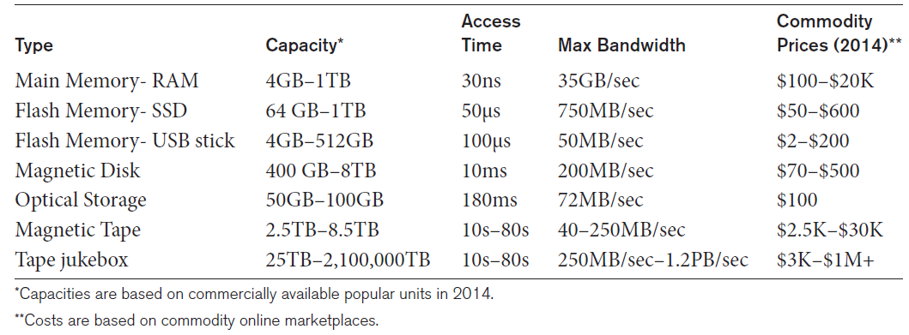
Storage Types and Characteristics
Table 16.1 Types of Storage with Capacity, Access Time, Max Bandwidth (Transfer Speed), and Commodity Cost

Slide 6
Storage Organization of Databases
Persistent data
Most databases
Transient data
Exists only during program execution
File organization
Determines how records are physically placed on the disk
Determines how records are accessed

Slide 7
16.2 Secondary Storage Devices
Hard disk drive
Bits (ones and zeros)
Grouped into bytes or characters
Disk capacity measures storage size
Disks may be single or double-sided
Concentric circles called tracks
Tracks divided into blocks or sectors
Disk packs
Cylinder

Slide 8
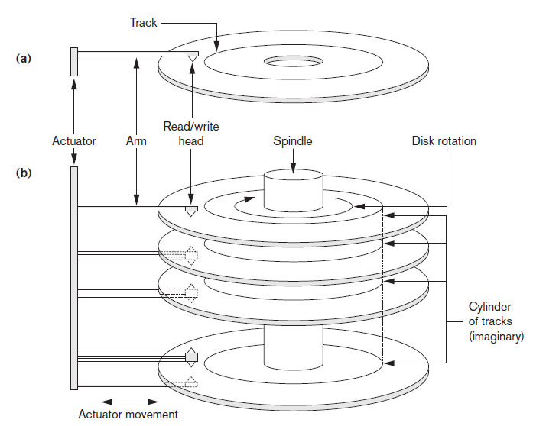
Single-Sided Disk and Disk Pack
Figure 16.1 (a) A single-sided disk with read/write hardware (b) A disk pack with read/write hardware

Slide 9
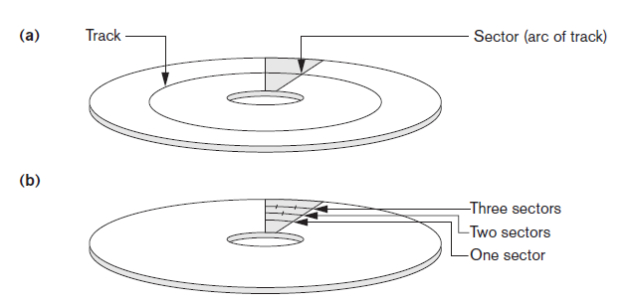
Sectors on a Disk
Figure 16.2 Different sector organizations on disk (a) Sectors subtending a fixed angle (b) Sectors maintaining a uniform recording density

Slide 10
Secondary Storage Devices (cont’d.)
Formatting
Divides tracks into equal-sized disk blocks
Blocks separated by interblock gaps
Data transfer in units of disk blocks
Hardware address supplied to disk I/O hardware
Buffer
Used in read and write operations
Read/write head
Hardware mechanism for read and write operations

Slide 11
Secondary Storage Devices (cont’d.)
Disk controller
Interfaces disk drive to computer system
Standard interfaces
SCSI
SATA
SAS

Slide 12
Secondary Storage Devices (cont’d.)
Techniques for efficient data access
Data buffering
Proper organization of data on disk
Reading data ahead of request
Proper scheduling of I/O requests
Use of log disks to temporarily hold writes
Use of SSDs or flash memory for recovery purposes

Slide 13
Solid State Device Storage
Sometimes called flash storage
Main component: controller
Set of interconnected flash memory cards
No moving parts
Data less likely to be fragmented
More costly than HDDs
DRAM-based SSDs available
Faster access times compared with flash

Slide 14
Magnetic Tape Storage Devices
Sequential access
Must scan preceding blocks
Tape is mounted and scanned until required block is under read/write head
Important functions
Backup
Archive

Slide 15
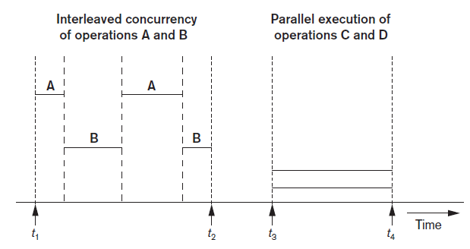
16.3 Buffering of Blocks
Buffering most useful when processes can run concurrently in parallel
Figure 16.3 Interleaved concurrency versus parallel execution

Slide 16
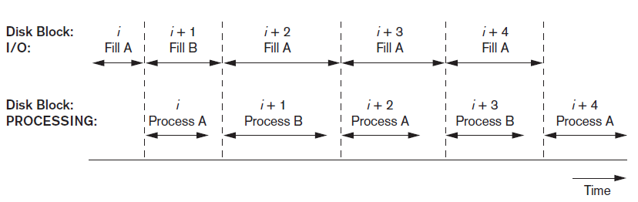
Buffering of Blocks (cont’d.)
Double buffering can be used to read continuous stream of blocks
Figure 16.4 Use of two buffers, A and B, for reading from disk

Slide 17
Buffer Management and Replacement Strategies
Buffer management goals:
(1) to maximize the probability that the requested page is found in main memory
(2) in case of reading a new disk block from disk, to find a page to replace that will cause the least harm in the sense that it will not be required shortly again.
Information
Pin count
Dirty bit

Slide 18
Buffer Management and Replacement Strategies
Pin count
The number of times that page has been requested, or
The number of current users of that page
If this count falls to zero, the page is considered unpinned.
Incrementing the pin-count is called pinning. In general, a pinned block should not be allowed to be written to disk
Dirty bit
Initially set to zero for all pages but is set to 1 whenever
that page is updated by any application program

Slide 19
Buffer Replacement Strategies
When a certain page is requested, the buffer manager takes following actions.
A) Page is in a buffer in the buffer pool :
if so, it increments its pin-count and releases the page.
B) Page is not in the buffer pool:
It chooses a page for replacement, using the replacement policy, and increments its pin-count.
If the dirty bit of the replacement page is on, the buffer manager writes that page to disk by replacing its old copy on disk. If the dirty bit is not on, this page is not modified and the buffer manager is not required to write it back to disk.
c. It reads the requested page into the space just freed up.
d. The main memory address of the new page is passed to the requesting application.

Slide 20
Buffer Management and Replacement Strategies
Buffer replacement strategies:
1) Least recently used (LRU)
Throw out that page that has not been used (read or written) for the longest time.
Buffer manager maintains a table where it records the time every time a page in a buffer is accessed
2) Clock policy
Round-robin variant of the LRU policy.
Each buffer has a flag with a 0 or 1 value. Buffers with a 0 are vulnerable and may be used for replacement and their contents read back to disk. Buffers with a 1 are not vulnerable.

Slide 21
Buffer Management and Replacement Strategies
Buffer replacement strategies
3) First-in-first-out (FIFO)
Buffer that has been occupied the longest by a page is used for replacement
Buffer manager notes the time each page gets loaded into a buffer; but it does not have to keep track of the time pages are accessed

Slide 22
16.4 Placing File Records on Disk
Record: collection of related data values or items
Values correspond to record field
Data types
Numeric
String
Boolean
Date/time
Binary large objects (BLOBs)
Unstructured objects

Slide 23
Placing File Records on Disk (cont’d.)
Reasons for variable-length records
One or more fields have variable length
The Name field of EMPLOYEE can be a variable-length field.
One or more fields are repeating
Multiple values of a field for individual records
One or more fields are optional
They may have values for some but not all of the file records

Slide 24
Placing File Records on Disk (cont’d.)

Slide 25
Record Blocking and Spanned Versus Unspanned Records
File records allocated to disk blocks
Spanned records
Larger than a single block
Pointer at end of first block points to block containing remainder of record
Unspanned
Records not allowed to cross block boundaries

Slide 26
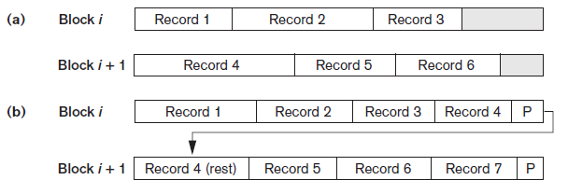
Record Blocking and Spanned Versus Unspanned Records (cont’d.)
Blocking factor
Average number of records per block for the file
Figure 16.6 Types of record organization (a) Unspanned (b) Spanned

Slide 27
Record Blocking and Spanned Versus Unspanned Records (cont’d.)
Allocating file blocks on disk
1) Contiguous allocation
The file blocks are allocated to consecutive disk blocks
Reading the whole file is very fast using double buffering, but it makes expanding the file difficult
2) Linked allocation
Each file block contains a pointer to the next file block.
Expanding the file is easy but makes it slow to read the whole file
3) Indexed allocation
Where one or more index blocks contain pointers to
the actual file blocks.

Slide 28
Record Blocking and Spanned Versus Unspanned Records (cont’d.)
File header (file descriptor)
Contains file information needed by system programs
Disk addresses
Format descriptions
i) For Fixed-length unspanned records
field lengths and the order of fields within a record
ii) For Variable-length records
field type codes, separator characters, and record type codes

Slide 29
16.5 Operations on Files
Retrieval operations
No change to file data
Update operations
File change by insertion, deletion, or modification
Records selected based on selection condition

Slide 30
Operations on Files (cont’d.)
Examples of operations for accessing file records
Open
Find
Read
FindNext
Delete
Insert
Close
Scan

Slide 31
16.6 Files of Unordered Records (Heap Files)
Heap (or pile) file
Records placed in file in order of insertion
Inserting a new record is very efficient
Searching for a record requires linear search
Deletion techniques
Rewrite the block
To delete a record, a program must first find its block, copy the block into a buffer, delete the record from the buffer, and finally rewrite the block back to the disk
Use deletion marker
Have an extra byte or bit, called a deletion marker, stored with each record. A record is deleted by setting the deletion marker to a certain value

Slide 32
16.7 Files of Ordered Records (Sorted Files)
Ordered (sequential) file
Records sorted by ordering field
Called ordering key if ordering field is a key field
Advantages
Reading records in order of ordering key value is extremely efficient
Finding next record
Binary search technique

Slide 33
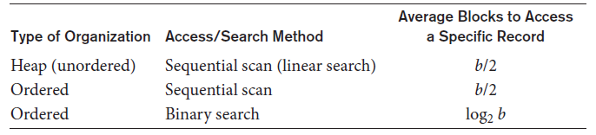
Access Times for Various File Organizations
Table 16.3 Average access times for a file of b blocks under basic file organizations

Slide 34
16.8 Hashing Techniques
Hash function (randomizing function)
Applied to hash field value of a record
Yields address of the disk block of stored record
Organization called hash file
Search condition is equality condition on the hash field
Hash field typically key field
Hashing also internal search structure
Used when group of records accessed exclusively by one field value

Slide 35
Hashing Techniques (cont’d.)
Internal hashing
Hash table
Collision
Hash field value for inserted record hashes to address already containing a different record
Collision resolution
Open addressing
Chaining
Multiple hashing

Slide 36
Hashing Techniques (cont’d.)
External hashing for disk files
Target address space made of buckets
Bucket: one disk block or contiguous blocks
Hashing function maps a key into relative bucket
Table in file header converts bucket number to disk block address
Collision problem less severe with buckets
Static hashing
Fixed number of buckets allocated

Slide 37
Hashing Techniques (cont’d.)
Hashing techniques that allow dynamic file expansion
Extendible hashing
File performance does not degrade as file grows
Dynamic hashing
Maintains tree-structured directory
Linear hashing
Allows hash file to expand and shrink buckets without needing a directory

Slide 38
16.9 Other Primary File Organizations
Files of mixed records
Relationships implemented by logical field references
Physical clustering
B-tree data structure
Column-based data storage

Slide 39
16.10 Parallelizing Disk Access Using RAID Technology
Redundant arrays of independent disks (RAID)
Goal: improve disk speed and access time
Set of RAID architectures (0 through 6)
Data striping
Bit-level striping
Block-level striping
Improving Performance with RAID
Data striping achieves higher transfer rates

Slide 40
Parallelizing Disk Access Using RAID Technology (cont’d.)
Improving reliability with RAID
Redundancy techniques: mirroring and shadowing
RAID organizations and levels
Level 0
Data striping, no redundant data
Spits data evenly across two or more disks
Level 1
Uses mirrored disks

Slide 41
Parallelizing Disk Access Using RAID Technology (cont’d.)
RAID organizations and levels (cont’d.)
Level 2
Hamming codes for memory-style redundancy
Error detection and correction
Level 3
Single parity disk relying on disk controller
Levels 4 and 5
Block-level data striping
Data distribution across all disks (level 5)

Slide 42
Parallelizing Disk Access Using RAID Technology (cont’d.)
RAID organizations and levels (cont’d.)
Level 6
Applies P+Q redundancy scheme
Protects against up to two disk failures by using just two redundant disks
Rebuilding easiest for RAID level 1
Other levels require reconstruction by reading multiple disks
RAID levels 3 and 5 preferred for large volume storage

Slide 43
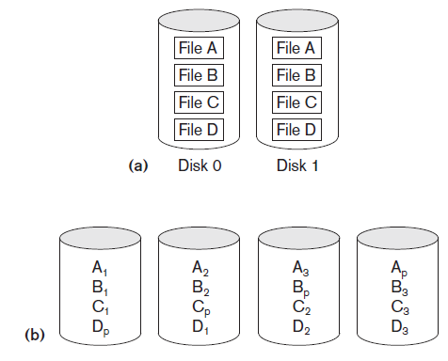
RAID Levels
Figure 16.14 Some popular levels of RAID (a) RAID level 1: Mirroring of data on two disks (b) RAID level 5: Striping of data with distributed parity across four disks

Slide 44
16.11 Modern Storage Architectures
Storage area networks
Online storage peripherals configured as nodes on high-speed network
Network-attached storage
Servers used for file sharing
High degree of scalability, reliability, flexibility, performance
iSCSI
Clients send SCSI commands to SCSI storage devices on remote channels

Slide 45
Modern Storage Architectures (cont’d.)
Fibre Channel over IP (FCIP)
Fibre Channel control codes and data translated into IP packets
Transmitted between geographically distant Fibre Channel SANs
Fibre Channel over Ethernet (FCoE)
Similar to iSCSI without the IP

Slide 46
Modern Storage Architectures (cont’d.)
Automated storage tiering
Automatically moves data between different storage types depending on need
Frequently-used data moved to solid-state drives
Object-based storage
Data managed in form of objects rather than files made of blocks
Objects carry metadata and global identifier
Ideally suited for scalable storage of unstructured data

Slide 47
16.12 Summary
Magnetic disks
Accessing a disk block is expensive
Commands for accessing file records
File organizations: unordered, ordered, hashed
RAID
Modern storage trends

